Slide 1
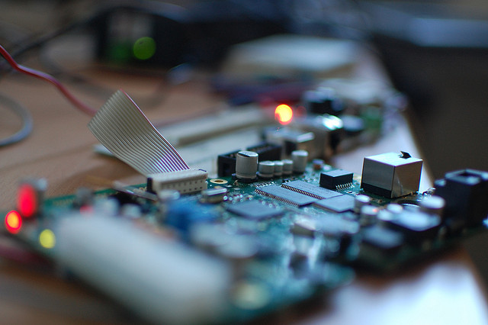


Hands-on with CoAP
Matthias Kovatsch Julien Vermillard
Embrace the Internet of Things!

Slide 2
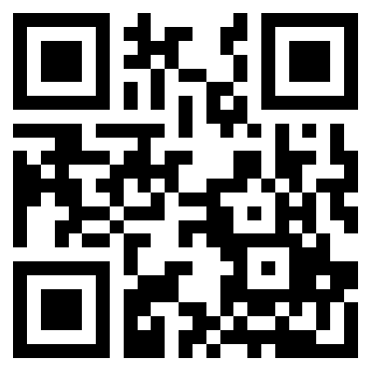
Follow the slides
http://goo.gl/LLQ03w

Slide 3
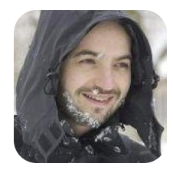
Your devoted presenters :-)
Julien Vermillard / @vrmvrm Software Engineer at Sierra Wireless http://airvantage.net M2M Cloud
Apache member, Eclipse committer on Californium and Wakaama
More IoT stuff:
https://github.com/jvermillard

Slide 4
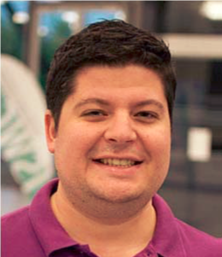
Your devoted presenters :-)
Matthias Kovatsch
Researcher at ETH Zurich, Switzerland Focus on Web technology for the IoT
IETF contributor in CoRE and LWIG
Author of Californium (Cf), Erbium (Er), and Copper (Cu)
http://people.inf.ethz.ch/mkovatsc

Slide 5
Agenda
Internet of things 101
What protocols should I use?
CoAP
What is CoAP?
CoAP live!
Californium
HANDS-ON!
More CoAP goodies

Slide 6
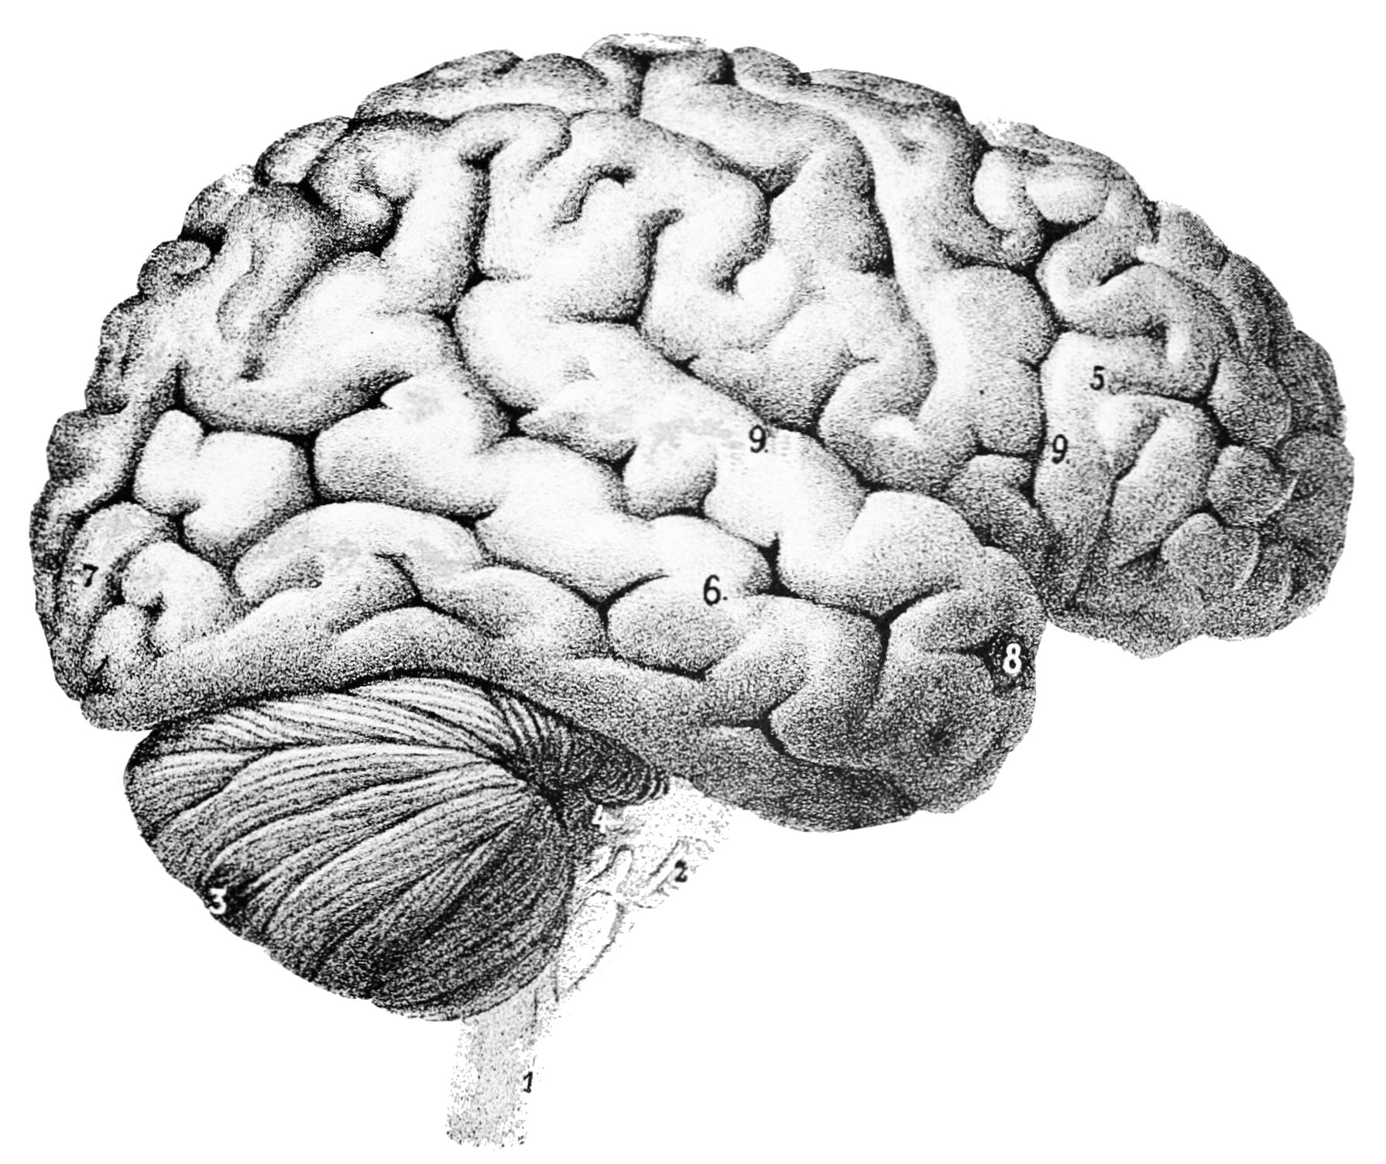
What you will need
Eclipse IDE
Basic Java knowledge
Californium JARs
Firefox + Copper
Your brainzzz

Slide 7

Content of the USB stick
Eclipse IDE for Windows, Linux and Mac
Firefox and Copper .xpi
Sample projects to be imported in your workspace
+ Californium JAR file
Completed projects

Slide 8
Machine to machine?

Slide 9
Machine to machine?
Internet of things?

Slide 10
❝
Technology that supports
wired or wireless
communication
between devices

Slide 11
Different needs, different protocols
Device Management
Radio statististics, device configuration, …
OMA-DM, TR-069, LWM2M…
Local sensor networks
Transmit sensor data, usually over RF or PLC
Zigbee, X10, Bluetooth Smart, …
End-user applications
Display sensor data on mobile app, dashboards,
HTTP, Websockets, ...

Slide 12
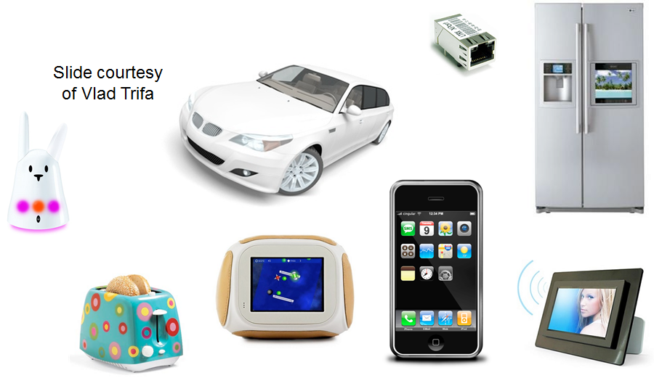
The Web of Things
Notes:
@10 mins

Slide 13

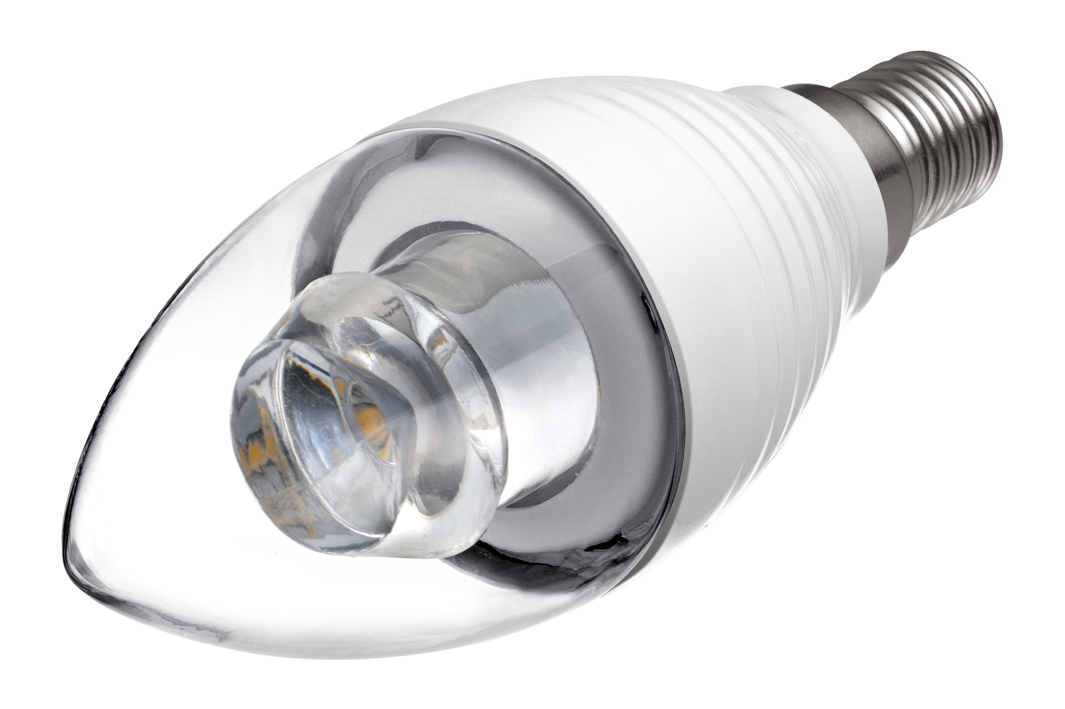
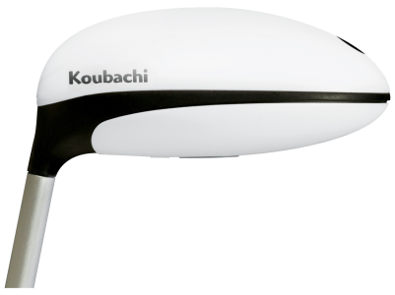


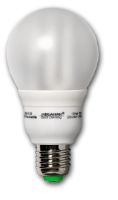
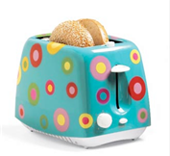
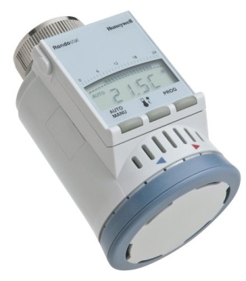
Application-layer interoperability and usability for the IoT
Well-known patterns
Cloud services
Web mashups

Slide 14
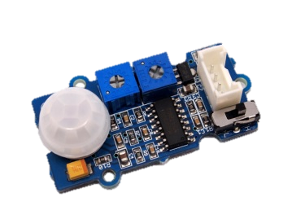
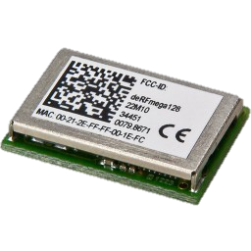
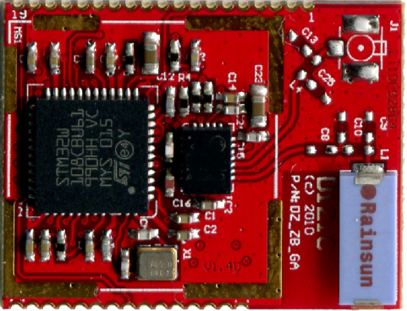
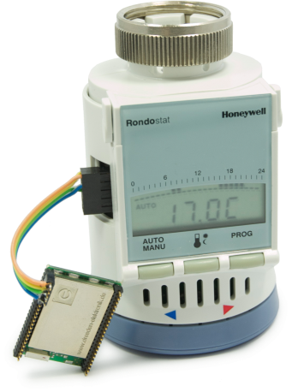
Tiny Resource-constrained devices
Class 1 devices
~100KiB Flash
~10KiB RAM
Low-power networks
Notes:
@15 mins

Slide 15
Tiny Resource-constrained devices
Target of less than $1
for IoT SoC
TCP and HTTP
are not a good fit
Notes:
@15 mins

Slide 16
Constrained Application Protocol
RESTful protocol designed from scratch
Transparent mapping to HTTP
Additional features for M2M scenarios
Request/Response Sub-layer
RESTful interaction
GET, POST, PUT, DELETE
URIs and Internet Media Types
CoAP
Message Sub-layer
Reliability
Deduplication
Optional retransmissions
(Confirmables “CON”)
UDP
DTLS
…

Slide 17
Constrained Application Protocol
Binary protocol
Low parsing complexity
Small message size
Options
Numbers in IANA registry
Type-Length-Value
Special option header marks payload if present
4-byte Base Header
Version | Type | T-len | Code | ID
0 – 8 Bytes Token
Exchange handle for client
Options
Location, Max-Age, ETag, …
Marker
0xFF
Payload
Representation
Notes:
0..255 | IETF Review or IESG approval
256..2047 | Specification Required
2048..64999 | Designated Expert
65000..65535 | Reserved for experiments

Slide 18
Observing resources
Resource state at origin server
Observe illustration courtesy of Klaus Hartke
Server
GET Observe
Notification
Notification
Notification
Notification
lost
Notification
Client
Replicated state at client
Max-Age
Notes:
Caching

Slide 19
Observing resources - CON mode
Resource state at origin server
Observe illustration courtesy of Klaus Hartke
Server
GET Observe
Notification
Notification
Notification
Retransmission
Notification
Client
Replicated state at client
Notes:
Caching

Slide 20
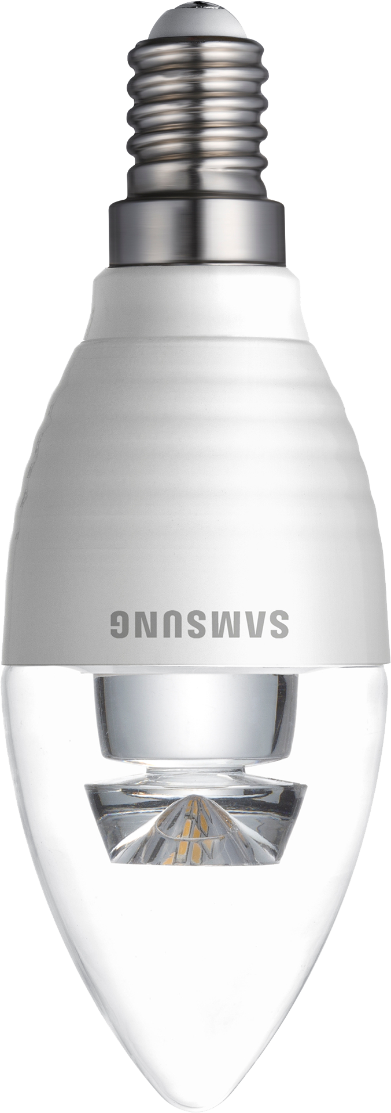

RESTful group communication
GET /status/power
all-lights.floor-d.example.com
PUT /control/onoff
PUT /control/color #00FF00

Slide 21
Resource discovery
Based on Web Linking (RFC5988)
Extended to Core Link Format (RFC6690)
Decentralized discovery Multicast Discovery
Infrastructure-based Resource Directories
GET /.well-known/core
</config/groups>;rt="core.gp";ct=39, </sensors/temp>;rt="ucum.Cel";ct="0 50";obs, </large>;rt="block";sz=1280,
</device>;title="Device management"

Slide 22
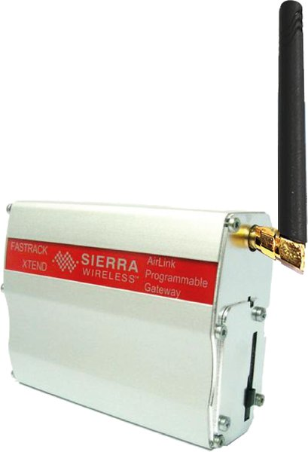

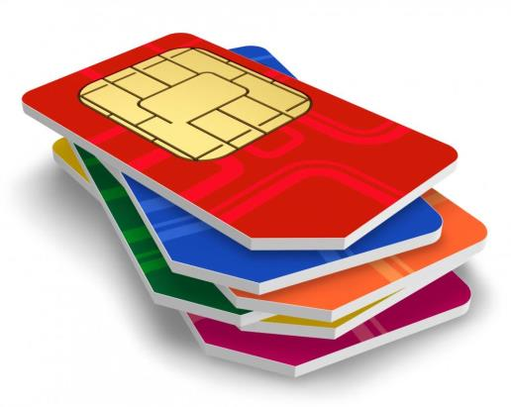
Alternative transports
Short Message Service (SMS)
Unstructured Supplementary Service Data (USSD)
*101# l
Addressable through URIs
Could power up subsystems for IP connectivity after SMS signal
coap+sms://+123456789/bananas/temp*
* illustration only, +123456789 unfortunately not allowed by URI RFC

Slide 23
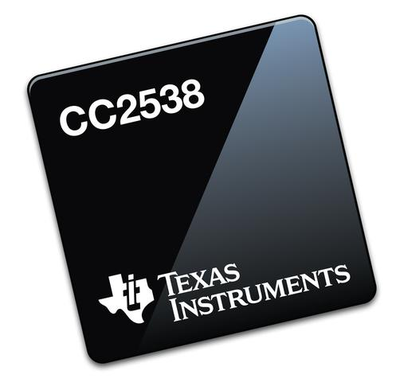
Security
Based on DTLS (TLS/SSL for Datagrams)
Focus on Elliptic Curve Cryptography (ECC)
Pre-shared secrets, certificates, or raw public keys
Hardware acceleration in IoT devices
IETF is currently working on
Authentication/authorization (ACE)
DTLS profiles (DICE)
e.g.,

Slide 24

Status of CoAP
Proposed Standard since 15 Jul 2013
RFC 7252
Next working group documents in the queue
Observing Resources
Group Communication
Blockwise Transfers
Resource Directory
HTTP Mapping Guidelines

Slide 25



Status of CoAP
In use by
OMA Lightweight M2M
IPSO Alliance
ETSI M2M / OneM2M
Device management for network operators
Lighting systems for smart cities

Slide 26
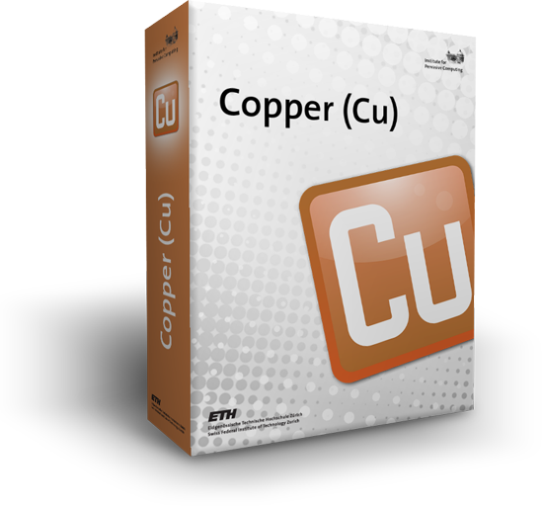
CoAP live with Copper!
CoAP protocol handler for Mozilla Firefox
Browsing and bookmarking
of CoAP URIs
Interaction with resource like
RESTClient or Poster
Treat tiny devices like
normal RESTful Web services
https://github.com/mkovatsc/Copper
https://addons.mozilla.org/en-US/firefox/addon/copper-270430/
Notes:
@30 mins

Slide 27
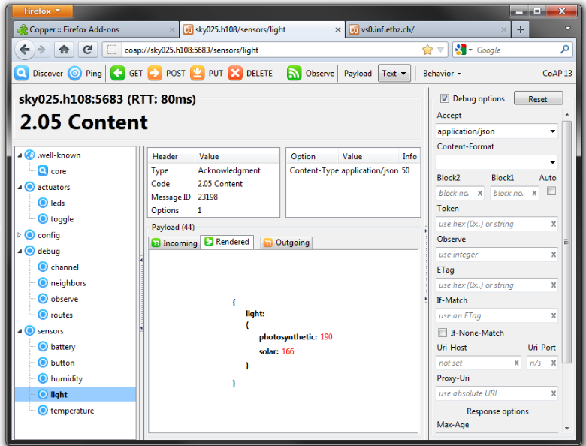
Copper (Cu) CoAP user-agent

Slide 28
CoAP live with Copper!
Available sandboxes:
coap://californium.eclipse.org:5683/
same as
coap://vs0.inf.ethz.ch:5683/
coap://coap.me:5683/
Notes:
Time to ask questions

Slide 29
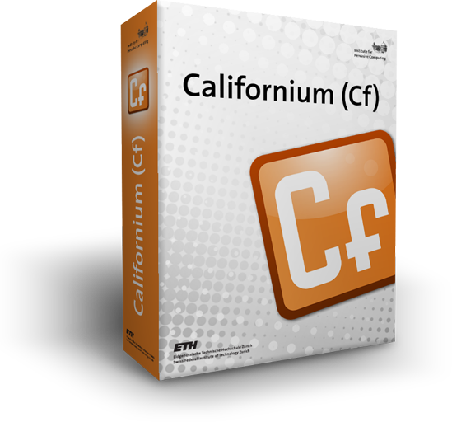
Notes:
@40 mins or earlier if only a few questions

Slide 30
Californium (Cf) CoAP framework
Unconstrained CoAP implementation
written in Java
focus on scalability and usability
For
IoT cloud services
Stronger IoT devices (Java SE Embedded or special JVMs)

Slide 31
3-stage architecture
Stages
Decoupled with message queues
independent concurrency models
Adjusted statically for platform/application
Stage 1 depends on OS and transport
Stage 2 usually one thread per core
A1
A
A2
Stage 3: Logic
Root
B1
B
B2
Blockwise Layer
Exchange Store
Observe Layer
Token Layer
Stage 2: Protocol (CoAP)
Reliability Layer
Matching & Deduplication
Message Serialization
Stage 1
Network
Transport (socket I/O)

Slide 32
Stage 3: server role
Web resources
Optional thread pool for each Web resource
Inherited by parent or transitive ancestor
Protocol threads used if none defined
A1
A
A2
Stage 3: Logic
Root
B1
B
B2
Blockwise Layer
Exchange Store
Observe Layer
Token Layer
Stage 2: Protocol (CoAP)
Reliability Layer
Matching & Deduplication
Message Serialization
Stage 1
Network
Transport (socket I/O)

Slide 33
Stage 3: client role
Clients with
response handlers
Object API called from main or user thread
Synchronous: Protocol threads unblock API calls
Asynchronous: Optional thread pools for response handling (e.g., when observing)
Client for A
main
Stage 3: Logic
Async. Client
Client for B
Blockwise Layer
Exchange Store
Observe Layer
Token Layer
Stage 2: Protocol (CoAP)
Reliability Layer
Matching & Deduplication
Message Serialization
Stage 1
Network
Transport (socket I/O)

Slide 34
Endpoints
Encapsulate stages 1+2
Enable
multiple channels
stack variations for different transports
Individual concurrency models, e.g., for DTLS
A1
A
A2
Stage 3: Logic
Root
B1
B
B2
Stack
Stack
Stack
Stage 2: Protocol (CoAP)
Stage 1
UDP
DTLS
...

Slide 35
Endpoints
CoapEndpoint
Message
Message
Exchange
Exchange
CoapStack
StackTopAdapter
MessageDeliverer
Blockwise Layer
Implemented in
CoapEndpoint
Separation of
bookkeeping and processing
Exchanges carry state
Observe Layer
Token Layer
Reliability Layer
Message
Message
Exchange
Exchange
Message
Outbox (Impl)
Exchange
Message
Inbox Impl
(RawDataChannel from element-connector)
Matcher
Deduplicator
Message
Message
MessageInterceptor
MessageInterceptor
MessageInterceptor
Data Serializer
Data Parser
Message
Connector
Data
Data

Slide 36
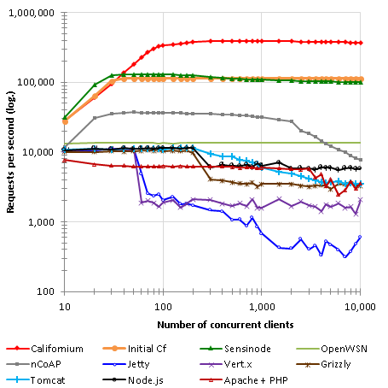
Paper on evaluation
at IoT 2014
Matthias Kovatsch, Martin Lanter, and Zach Shelby. Scalable Cloud Services for the Internet of Things. In Proc. IoT, Cambridge, MA, USA, 2014.
http://www.vs.inf.ethz.ch/publ/papers/mkovatsc-2014-iot-californium.pdf
Requests per second
Without Keep-Alive

Slide 37

Let’s get concrete!
Notes:
@50 mins

Slide 38
Project structure
Six repositories on GitHub
https://github.com/eclipse/californium Parent Maven POM with project metadata
https://github.com/eclipse/californium.element-connector Abstraction for datagram-based transports (UDP, DTLS)
https://github.com/eclipse/californium.scandium DTLS 1.2 implementation for network stage (DtlsConnector)
https://github.com/eclipse/californium.core Core libraries and example projects including Plugtest client/server
https://github.com/eclipse/californium.tools Stand-alone CoAP tools such as console client or RD
https://github.com/eclipse/californium.actinium App server for IoT mashups with JavaScript

Slide 39
Maven
Maven artifacts are available at
https://repo.eclipse.org/content/repositories/californium-snapshots/
https://repo.eclipse.org/content/repositories/californium-releases/
and releases at Maven Central
http://search.maven.org/#search|ga|1|californium

Slide 40
Code structure
https://github.com/eclipse/californium.core
Libraries (“californium-” prefix)
californium-core CoAP, client, server
californium-osgi OSGi wrapper
californium-proxy HTTP cross-proxy
Example code
Example projects (“cf-” prefix)

Slide 41
Code structure
https://github.com/eclipse/californium.core
Libraries
Example code
cf-android Android Studio project
cf-api-demo API call snippets
Example projects

Slide 42
Code structure
https://github.com/eclipse/californium.core
Libraries
Example code
Example projects
cf-helloworld-client basic GET client
cf-helloworld-server basic server
cf-plugtest-checker tests Plugtest servers
cf-plugtest-client tests client functionality
cf-plugtest-server tests server functionality
cf-benchmark performance tests
cf-secure imports Scandium (DTLS)
cf-proxy imports californium-proxy

Slide 43
Server API
Important classes (see org.eclipse.californium.core)
CoapServer
CoapResource
CoapExchange
Implement custom resources by extending CoapResource
Add resources to server
Start server

Slide 44
Server API - resources
import static org.eclipse.californium.core.coap.CoAP.ResponseCode.*; // shortcuts
public class MyResource extends CoapResource {
@Override
public void handleGET(CoapExchange exchange) {
exchange.respond("hello world"); // reply with 2.05 payload (text/plain)
}
@Override
public void handlePOST(CoapExchange exchange) {
exchange.accept(); // make it a separate response
if (exchange.getRequestOptions()....) {
// do something specific to the request options
}
exchange.respond(CREATED); // reply with response code only (shortcut)
}
}
Notes:
Static imports are good shortcuts for ResponseCodes and the MediaTypeRegistry

Slide 45
Server API - creation
public static void main(String[] args) {
CoapServer server = new CoapServer();
server.add(new MyResource("hello"));
server.start(); // does all the magic
}

Slide 46
Client API
Important classes
CoapClient
CoapHandler
CoapResponse
CoapObserveRelation
Instantiate CoapClient with target URI
Use offered methods get(), put(), post(), delete(), observe(), validate(), discover(), or ping()
Optionally define CoapHandler for asynchronous requests and observe

Slide 47
Client API - synchronous
public static void main(String[] args) {
CoapClient client1 = new CoapClient("coap://iot.eclipse.org:5683/multi-format");
String text = client1.get().getResponseText(); // blocking call
String xml = client1.get(APPLICATION_XML).getResponseText();
CoapClient client2 = new CoapClient("coap://iot.eclipse.org:5683/test");
CoapResponse resp = client2.put("payload", TEXT_PLAIN); // for response details
System.out.println( resp.isSuccess() );
System.out.println( resp.getOptions() );
client2.useNONs(); // use autocomplete to see more methods
client2.delete();
client2.useCONs().useEarlyNegotiation(32).get(); // it is a fluent API
}

Slide 48
Client API - asynchronous
public static void main(String[] args) {
CoapClient client = new CoapClient("coap://iot.eclipse.org:5683/separate");
client.get(new CoapHandler() { // e.g., anonymous inner class
@Override public void onLoad(CoapResponse response) { // also error resp.
System.out.println( response.getResponseText() );
}
@Override public void onError() { // I/O errors and timeouts
System.err.println("Failed");
}
});
}

Slide 49
Client API - observe
public static void main(String[] args) {
CoapClient client = new CoapClient("coap://iot.eclipse.org:5683/obs");
CoapObserveRelation relation = client.observe(new CoapHandler() {
@Override public void onLoad(CoapResponse response) {
System.out.println( response.getResponseText() );
}
@Override public void onError() {
System.err.println("Failed");
}
});
relation.proactiveCancel();
}

Slide 50
Advanced API
Get access to internal objects with
advanced() on CoapClient, CoapResponse, CoapExchange
Use clients in resource handlers with
createClient(uri);
Define your own concurrency models with
ConcurrentCoapResource and
CoapClient.useExecutor() / setExecutor(exe)

Slide 51

HANDS-ON!
Notes:
@ 60 mins -- pause

Slide 52
Getting started
Tutorial projects https://github.com/jvermillard/hands-on-coap
Launch Eclipse
Import projects contained on the USB stick
File > Import… > Existing projects into workspace

Slide 53
Step 1
The mandatory Hello world CoAP server!
Complete the code: Add “hello” resource with a custom message Run the CoAP server
Test with Copper

Slide 54
Step 2
Improve the server by adding:
A “subpath/another” hello world
Current time in milliseconds
A writable resource
A removable resource

Slide 55
Step 3
Hello world CoAP client
Complete the code for reading the previous “helloworld” values
Connect your client with your server

Slide 56
More fun
Connect with the LED strip
Read the sensors
Change the color
Have fun!

Slide 57
Where is the code?
Tutorial steps
https://github.com/jvermillard/hands-on-coap
Californium
https://github.com/eclipse?query=californium

Slide 58
Hands-off
Questions?

Slide 59
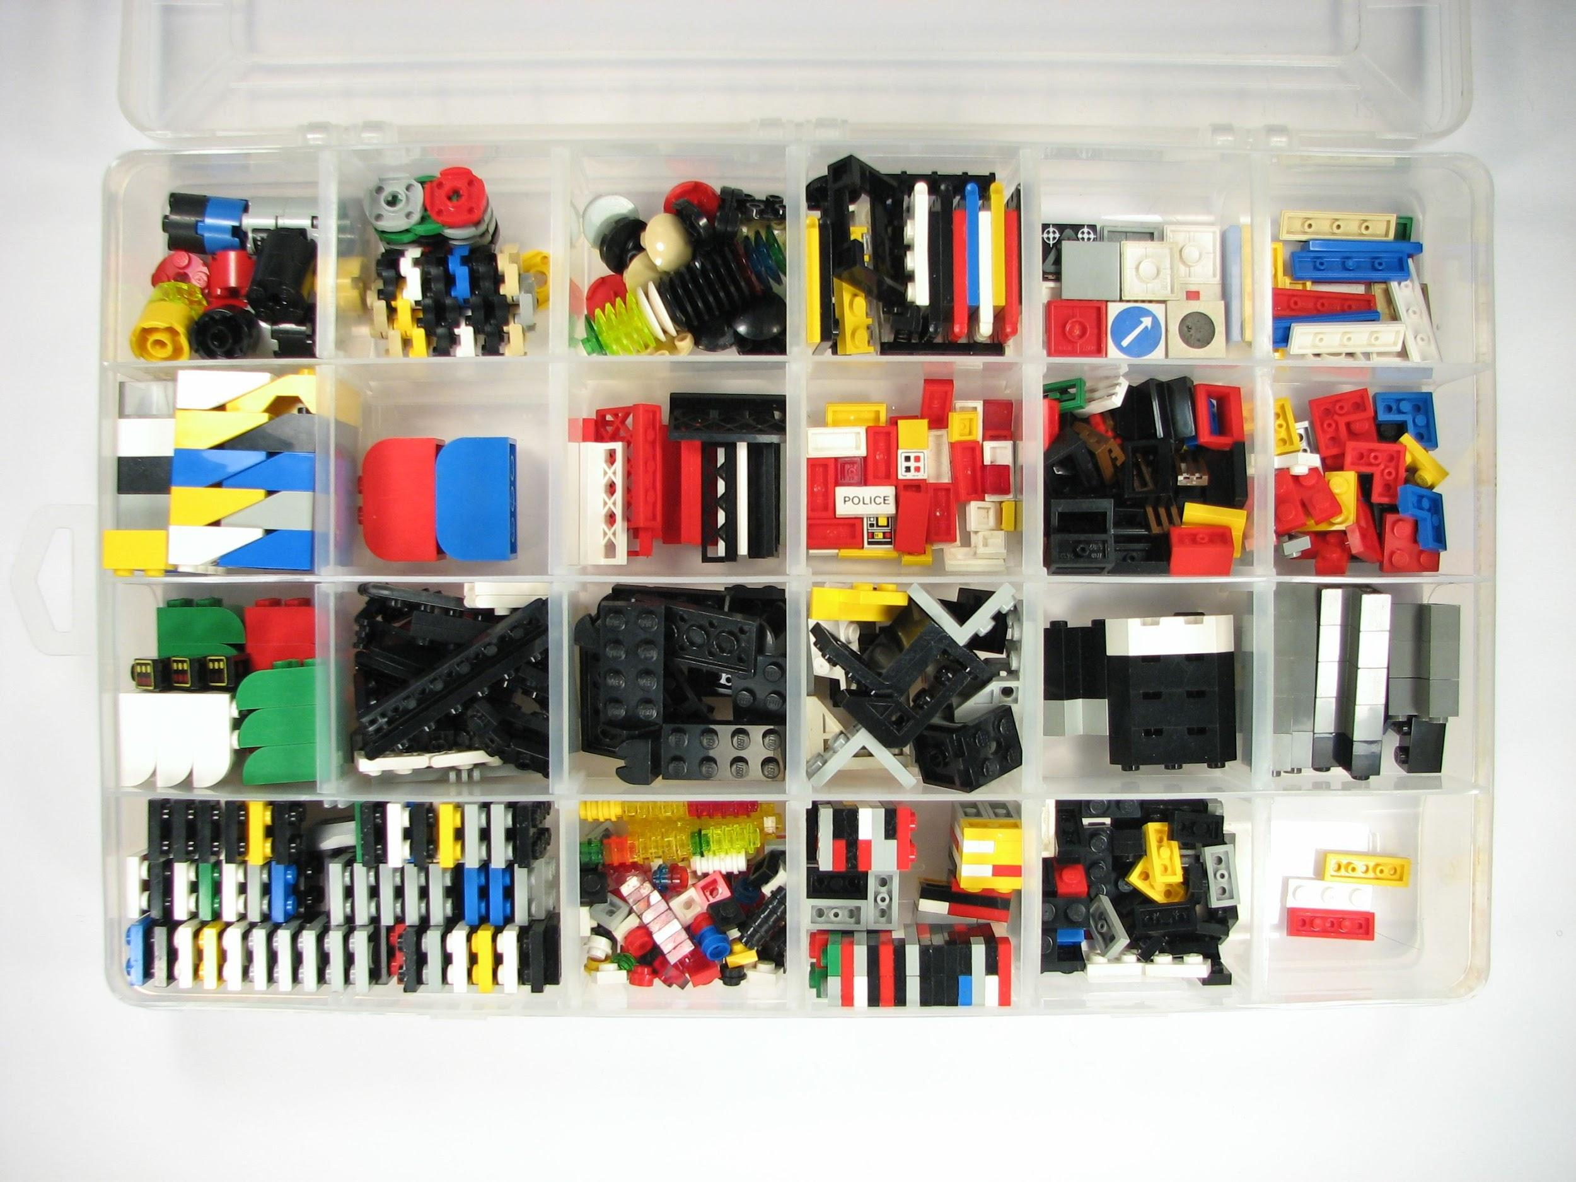
Going further with CoAP
Photo Credit:oskay

Slide 60
Going further with CoAP
Scandium (Sc)
DTLS (TLS/SSL for UDP) for adding security
Californium (Cf) Proxy
HTTP/CoAP proxy
Californium (Cf) RD
CoAP resource directory

Slide 61
Going further
Contiki OS
Connects tiny, low-power MCU to the Internet
http://contiki-os.org
Microcoap
CoAP for arduino
https://github.com/1248/microcoap

Slide 62
OMA Lightweight M2M
An device management protocol
Created by the Open Mobile Alliance
Configure, monitor, upgrade your device using CoAP over UDP and SMS
In a RESTful way!

Slide 63
OMA Lightweight M2M
The specification
http://technical.openmobilealliance.org
C client library (future eclipse wakaama)
http://github.com/01org/liblwm2m
Java server implementation
http://github.com/jvermillard/leshan/

Slide 64
Thanks!
More questions? Feel free to contact us!
Matthias Kovatsch
kovatsch@inf.ethz.ch
Julien Vermillard
@vrmvrm
jvermillard@sierrawireless.com

